Slide 1
Course Name: Database Systems Course Code: CS52 Credits: 3:1:0 UNIT 4 - Tutorial Term: September – December 2020
M.S. Ramaiah Institute of Technology
(Autonomous Institute, Affiliated to VTU)
Department of Computer Science and Engineering
Faculty:
Sini Anna Alex

Slide 2
Consider R(A,B,C,D,E,G,H) be a relation schema with set of functional dependencies:
F = {AB→C, B→D, CD→E, CE→GH, G→A}. prove the following
Infer AB→E from F
Infer GB→C from F
Infer CE→A from F

Slide 3
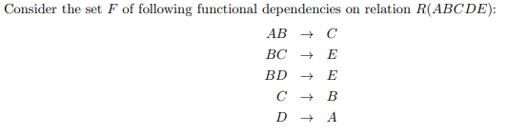
Compute the minimal Cover

Slide 4
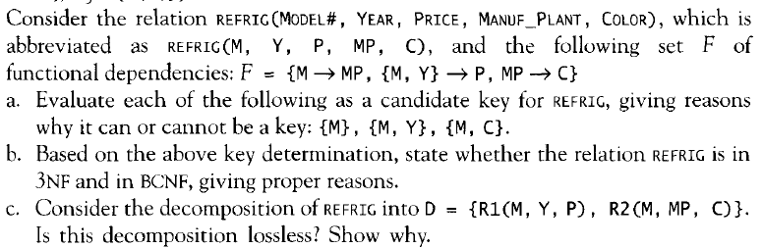

Slide 5
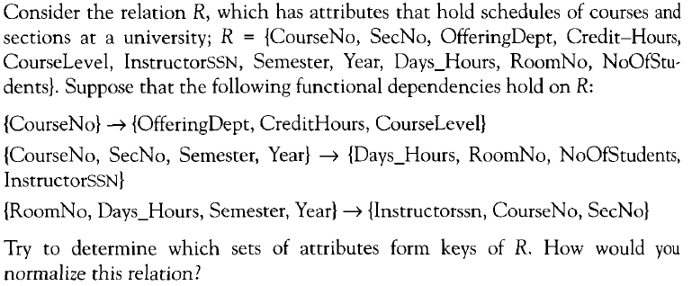

Slide 6

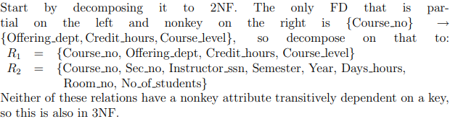
Solution

Slide 7
Thank you

